Slide 1
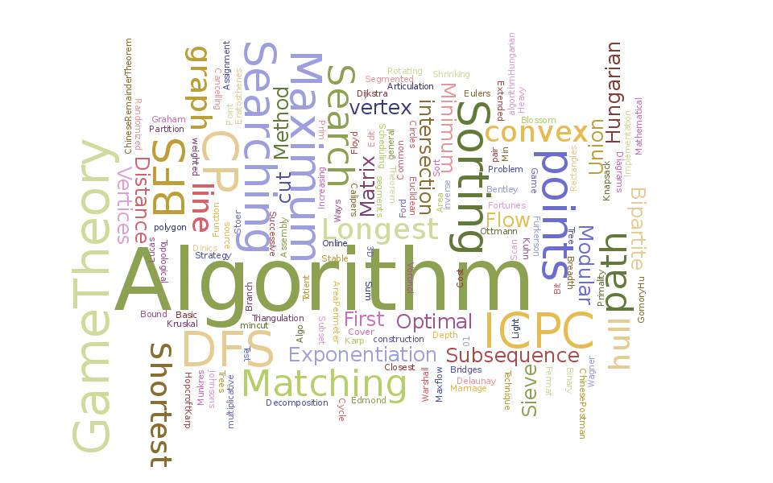
Data Structure and Algorithms
BS(CS) Semester 3
Jan-to-June 2020
Farhan Shafiq, Ph.D.

Slide 2
What is Data Structure
In computer terms, a data structure is a Specific way to store and organize data in a computer's memory so that these data can be used efficiently later. Data may be arranged in many different ways such as the logical or mathematical model for a particular organization of data is termed as a data structure. The variety of a particular data model depends on the two factors -
Firstly, it must be loaded enough in structure to reflect the actual relationships of the data with the real world object.
Secondly, the formation should be simple enough so that anyone can efficiently process the data each time it is necessary.

Slide 3
Categories of Data Structure
The data structure can be sub divided into major types:
Linear Data Structure
Non-linear Data Structure

Slide 4
Linear Data Structure
A data structure is said to be linear if its elements combine to form any specific order. There are basically two techniques of representing such linear structure within memory.

Slide 5
First way is to provide the linear relationships among all the elements represented by means of linear memory location. These linear structures are termed as arrays.
The second technique is to provide the linear relationship among all the elements represented by using the concept of pointers or links. These linear structures are termed as linked lists.
The common examples of linear data structure are:
Arrays
Queues
Stacks
Linked lists

Slide 6
Non-Linear Data Structure
This structure is mostly used for representing data that contains a hierarchical relationship among various elements.
Examples of Non Linear Data Structures are listed below:
Graphs
family of trees and
table of contents

Slide 7
Tree: In this case, data often contain a hierarchical relationship among various elements. The data structure that reflects this relationship is termed as rooted tree graph or a tree.
Graph: In this case, data sometimes hold a relationship between the pairs of elements which is not necessarily following the hierarchical structure. Such data structure is termed as a Graph.

Slide 8
Data Structure
Data Structure is a systematic way to organize data in order to use it efficiently. Following terms are the foundation terms of a data structure.

Slide 9
Interface − Each data structure has an interface. Interface represents the set of operations that a data structure supports. An interface only provides the list of supported operations, type of parameters they can accept and return type of these operations.
Implementation − Implementation provides the internal representation of a data structure. Implementation also provides the definition of the algorithms used in the operations of the data structure.

Slide 10
Characteristics of a Data Structure
Correctness − Data structure implementation should implement its interface correctly.
Time Complexity − Running time or the execution time of operations of data structure must be as small as possible.
Space Complexity − Memory usage of a data structure operation should be as little as possible.

Slide 11
Need for Data Structure
As applications are getting complex and data rich, there are three common problems that applications face now-a-days.

Slide 12
Data Search
Data Search − Consider an inventory of 1 million(10⁶) items of a store. If the application is to search an item, it has to search an item in 1 million(10⁶) items every time slowing down the search. As data grows, search will become slower.

Slide 13
Processor speed
Processor speed − Processor speed although being very high, falls limited if the data grows to billion records.

Slide 14
Multiple requests
Multiple requests − As thousands of users can search data simultaneously on a web server, even the fast server fails while searching the data.

Slide 15
Approach
To solve the above-mentioned problems, data structures come to rescue. Data can be organized in a data structure in such a way that all items may not be required to be searched, and the required data can be searched almost instantly.

Slide 16
Algorithm
Algorithm is a step-by-step procedure, which defines a set of instructions to be executed in a certain order to get the desired output. Algorithms are generally created independent of underlying languages, i.e. an algorithm can be implemented in more than one programming language.
From the data structure point of view, following are some important categories of algorithms

Slide 17
Search − Algorithm to search an item in a data structure.
Sort − Algorithm to sort items in a certain order.
Insert − Algorithm to insert item in a data structure.
Update − Algorithm to update an existing item in a data structure.
Delete − Algorithm to delete an existing item from a data structure.

Slide 18
Characteristics of an Algorithm
Unambiguous − Algorithm should be clear and unambiguous. Each of its steps (or phases), and their inputs/outputs should be clear and must lead to only one meaning.
Input − An algorithm should have 0 or more well-defined inputs.
Output − An algorithm should have 1 or more well-defined outputs, and should match the desired output.
Finiteness − Algorithms must terminate after a finite number of steps.
Feasibility − Should be feasible with the available resources.
Independent − An algorithm should have step-by-step directions, which should be independent of any programming code.

Slide 19
How to Write an Algorithm?
There are no well-defined standards for writing algorithms. Rather, it is problem and resource dependent. Algorithms are never written to support a particular programming code.
As we know that all programming languages share basic code constructs like loops (do, for, while), flow-control (if-else), etc. These common constructs can be used to write an algorithm.
We write algorithms in a step-by-step manner, but it is not always the case. Algorithm writing is a process and is executed after the problem domain is well-defined. That is, we should know the problem domain, for which we are designing a solution.

Slide 20
Example
Problem − Design an algorithm to add two numbers and display the result.
step 1 − START
step 2 − declare three integers a, b & c
step 3 − define values of a & b
step 4 − add values of a & b
step 5 − store output of step 4 to c
step 6 − print c
step 7 − STOP

Slide 21
step 1 − START ADD
step 2 − get values of a & b
step 3 − c ← a + b
step 4 − display c
step 5 − STOP

Slide 22
Basic Operations
The data in the data structures are processed by certain operations. The particular data structure chosen largely depends on the frequency of the operation that needs to be performed on the data structure.
Traversing
Searching
Insertion
Deletion
Sorting
Merging

Slide 23
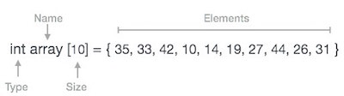
Arrays

Slide 24
Basic Operations
Following are the basic operations supported by an array.
Traverse − print all the array elements one by one.
Insertion − Adds an element at the given index.
Deletion − Deletes an element at the given index.
Search − Searches an element using the given index or by the value.
Update − Updates an element at the given index.

